Slide 1
Device management
Admin Portal​

Slide 2
Introduction
The Device Management Admin Portal is an Android application built using the MVVM (Model-View-View-Model) architecture.
It enables administrators to manage and monitor devices in an organization, with data synchronization between Room Database and Fire-store.
The application supports both online and offline modes.

Slide 3
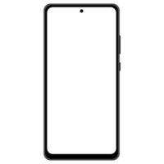
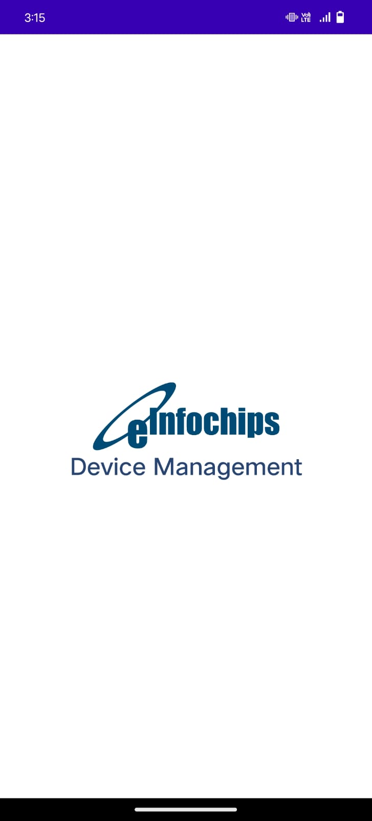
Screens and Description
Splash Screen
A splash screen is a graphical element that appears when an application is launched.
Its purpose is to provide an initial visual experience to the users while the main content is being loaded in the background.
It showcase the logo, of the company and name of the application.
It helps in establishing brand recognition and familiarity.

Slide 4
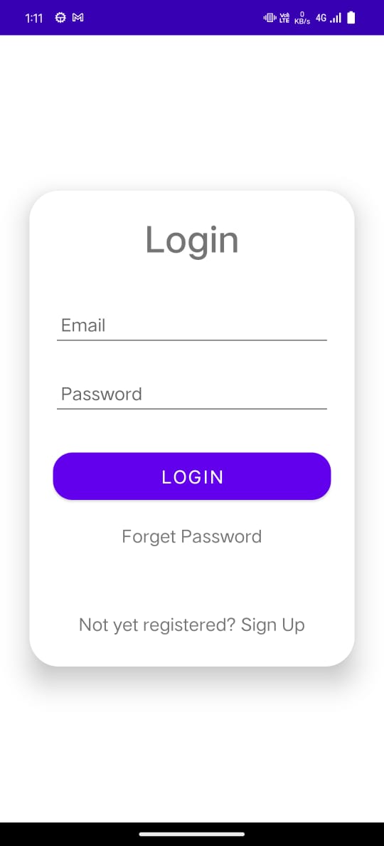
Login screen
The login screen serves as the entry point for administrators to access the system. It provides a secure way to authenticate admin and gain access to the system's features and functionalities.
Login Button: Clicking this button validates the entered credentials and grants access to the system for Admin only.
Sign Up Option: To cater to new administrators who don't have an account, a "Sign Up" link is included.
Forget password option: To Reset password a Reset Password link is included.
Error Handling: In case of invalid login credentials or other login-related errors, error messages is displayed as toast message.

Slide 5
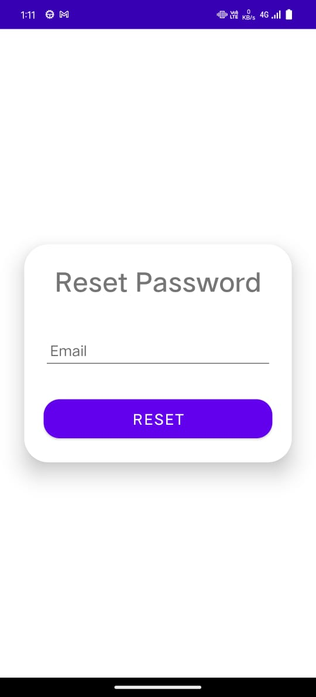
Reset Password screen
The reset password functionality allows users to regain access to their accounts by entering their email address. Upon submission, a reset link is sent to the provided email, enabling users to create a new password and secure their account.
Reset Button: Clicking this button validates the entered email and send reset password link to the email of the admin mentioned.
Error Handling: In case of invalid email credentials or other error messages is displayed as toast message.

Slide 6
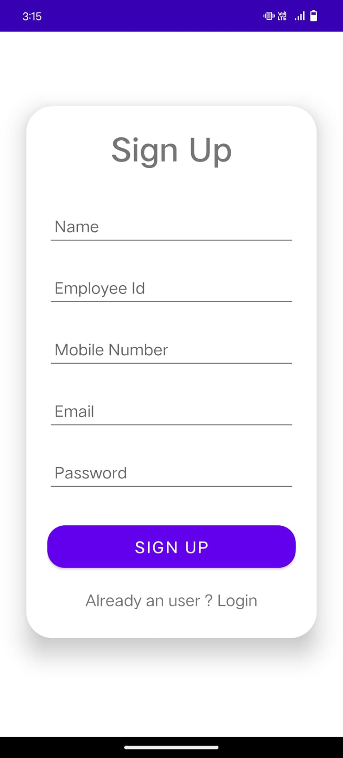
Signup screen
The signup screen allows new administrators to create an account and gain access to the system's features and functionalities.
Registration Form: The signup screen includes a registration form where new administrators can enter their information, such as name, employee id, mobile number, email address, and desired password.
Sign Up Button: Clicking this button validates the entered information, creates a new account, and grants access to the system for the newly registered administrator..
Error Handling: In case of any errors or missing information in the registration form, appropriate error messages are displayed to guide administrators in correcting the issues.
Login Option: For administrators who already have an account, a link to the login screen is included, allowing them to switch to the login process instead of signing up.

Slide 7
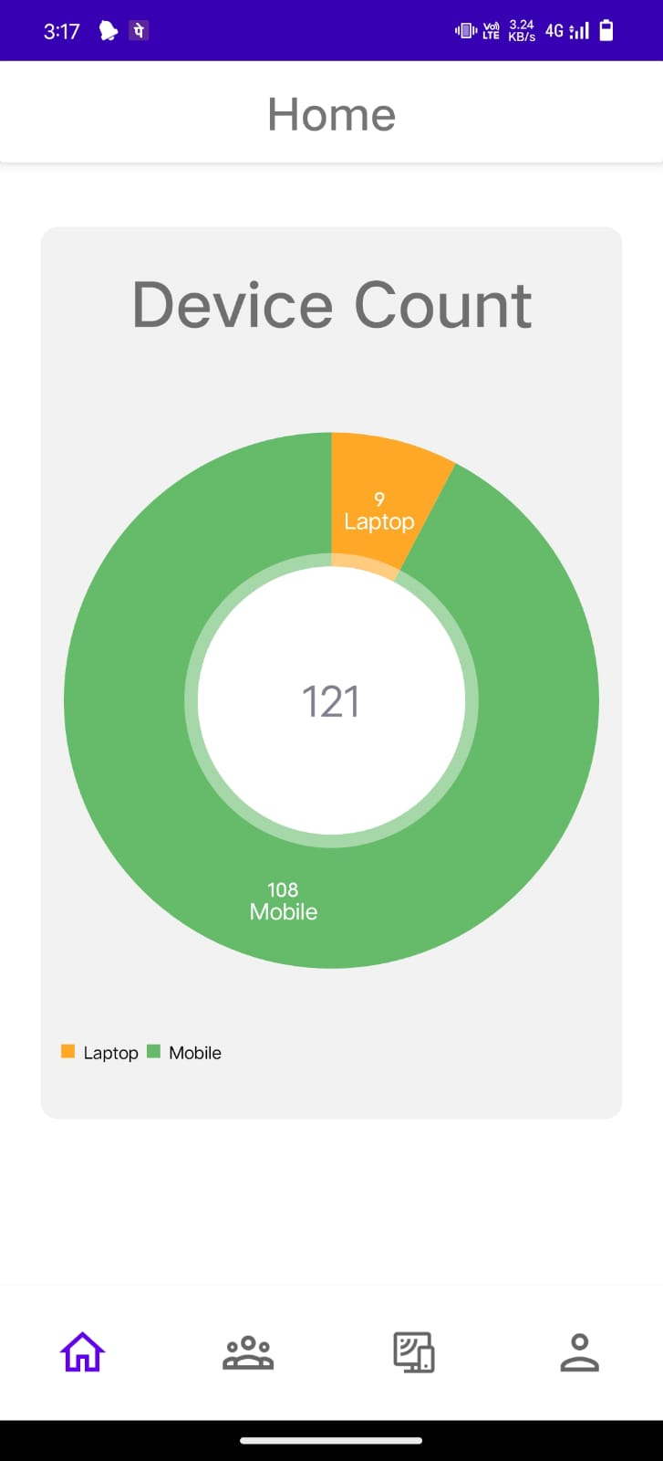
Dashboard screen
After successful logging into the system, administrators are redirected to the main dashboard activity. This dashboard includes a bottom navigation bar and a toolbar that indicates the screen name.
Home Screen: The home screen of the main dashboard displays the device count analytics in a pie chart format. The pie chart visually represents the distribution of devices across different categories or criteria, providing administrators with a quick overview of the device inventory.

Slide 8
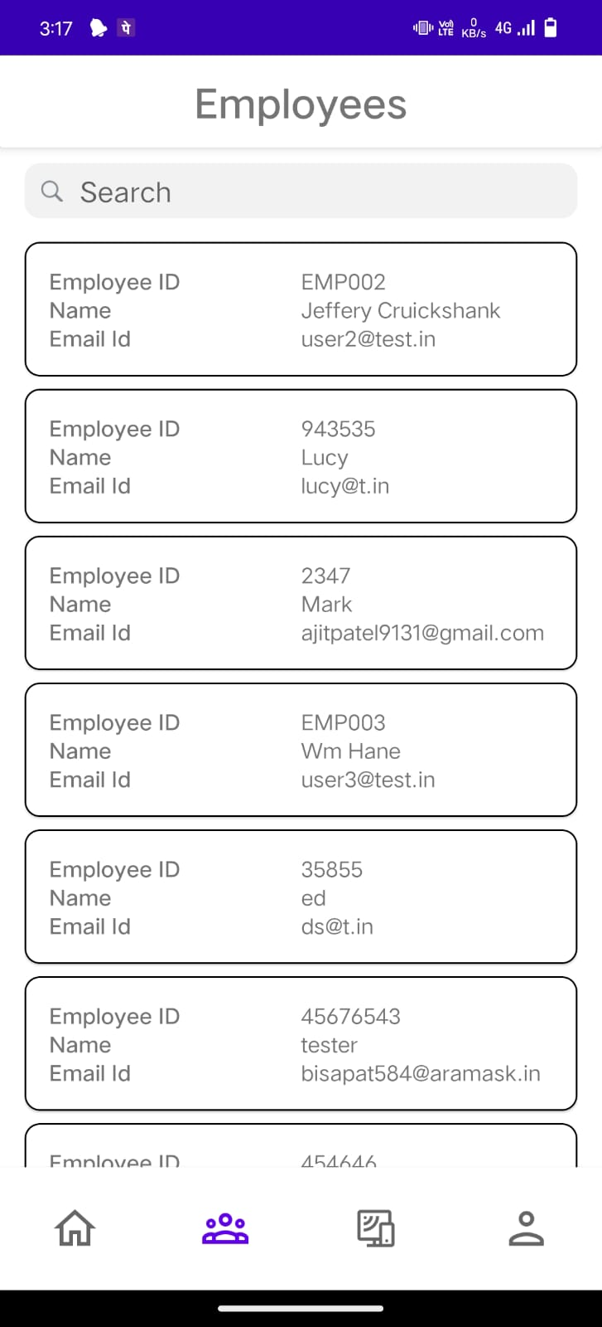
Employee Listing screen
The second icon on the dashboard screen leads to the employee listing screen. This screen provides a searchable list of employees and allows administrators to filter employees based on their ID or name using a search bar.
Employee List: The screen displays a list of employees, showing essential information such as their names, IDs, or email. This list is scrollable, depending on the number of employees in the system.
Clicking an Employee: When an administrator clicks on an employee from the list, it triggers an action to open the employee detail page.

Slide 9
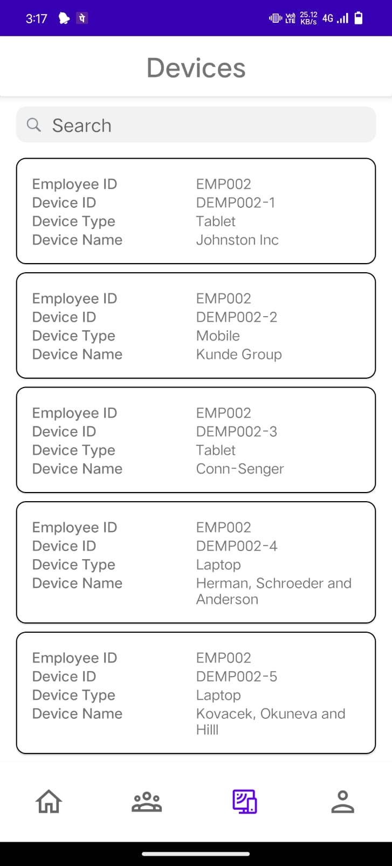
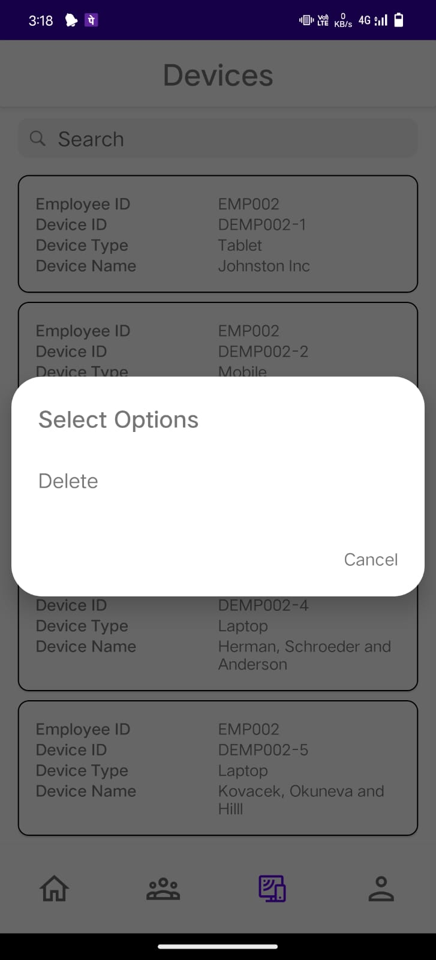
Device Listing screen
The third icon on the dashboard screen leads to the device listing screen. This screen provides a searchable list of devices and allows administrators to filter devices based on their ID , name or employee-id using a search bar.
Device List: The screen displays a list of devices, showing essential information such as their employee-id, device id, or device type and device name. This list is scrollable, depending on the number of devices in the system.
Clicking an device: When an administrator clicks on an employee from the list, it triggers an action to open the device detail page.
Long Click action on device: When an administrator long click on an device from the list, it triggers a dialog box for delete device.

Slide 10
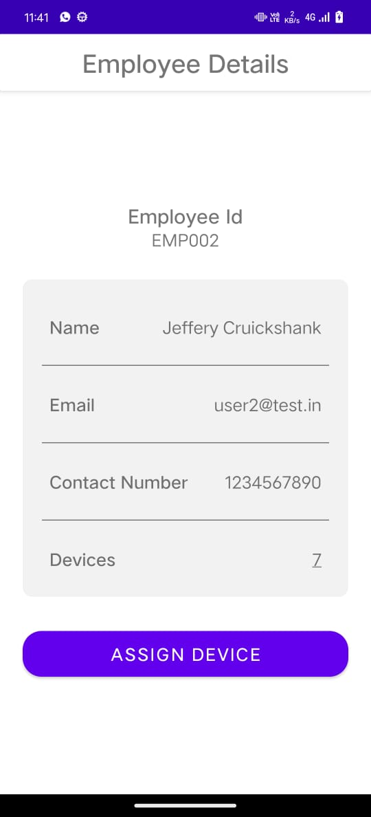
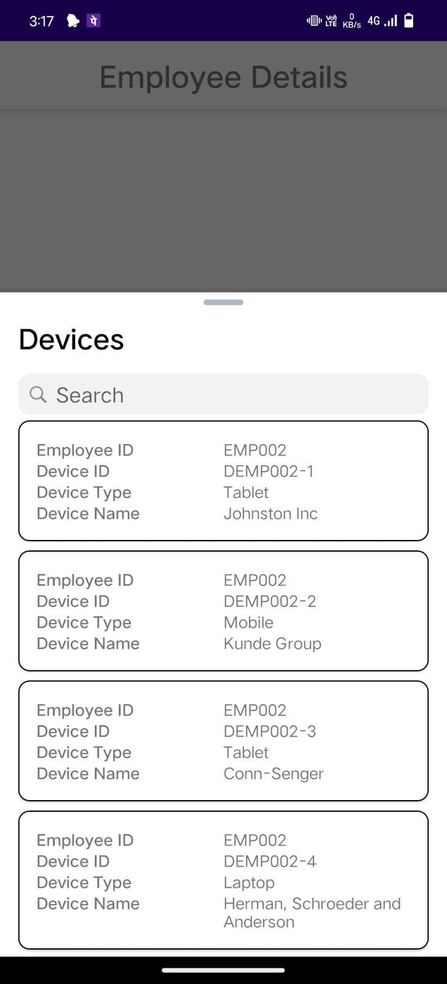
EMPLOYEE DETAIL screen
Employee detail screen displays the details of the employee information such as employee id, email, contact number and if the employee has device, then the count of device of the employee.
When we click to the devices tile in the detail page then it will open a bottom dialog sheet showing the list of devices of the employee and a search bar that can filter the devices based on device id.
Assign Button: The "Assign" button in the employee detail section allows the admin to assign a device to a specific employee. When the admin clicks on the "Assign" button, it triggers the opening of the "Assign Device" form, where the admin can select the device to be assigned.

Slide 11
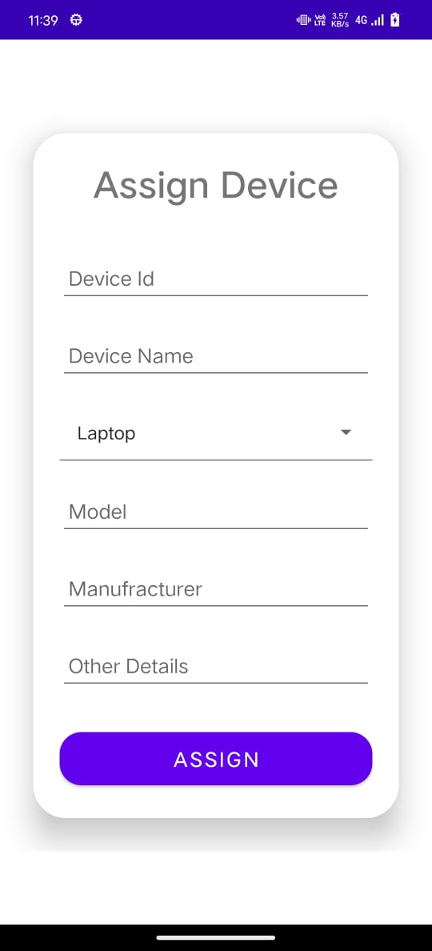
Assign Device screen
When clicking the "Assign" button in the employee detail section, an "Assign Device" form appears.
The form includes fields like device ID, device name, model, manufacturer, other details , and a device type selection spinner.
If the device ID already exists (assigned to another employee), a message will be displayed stating that the device is already assigned.
Upon assigning the device to the employee and submitting the form:
- The device details and employee detail will be updated.
- The device becomes associated with the particular employee.

Slide 12
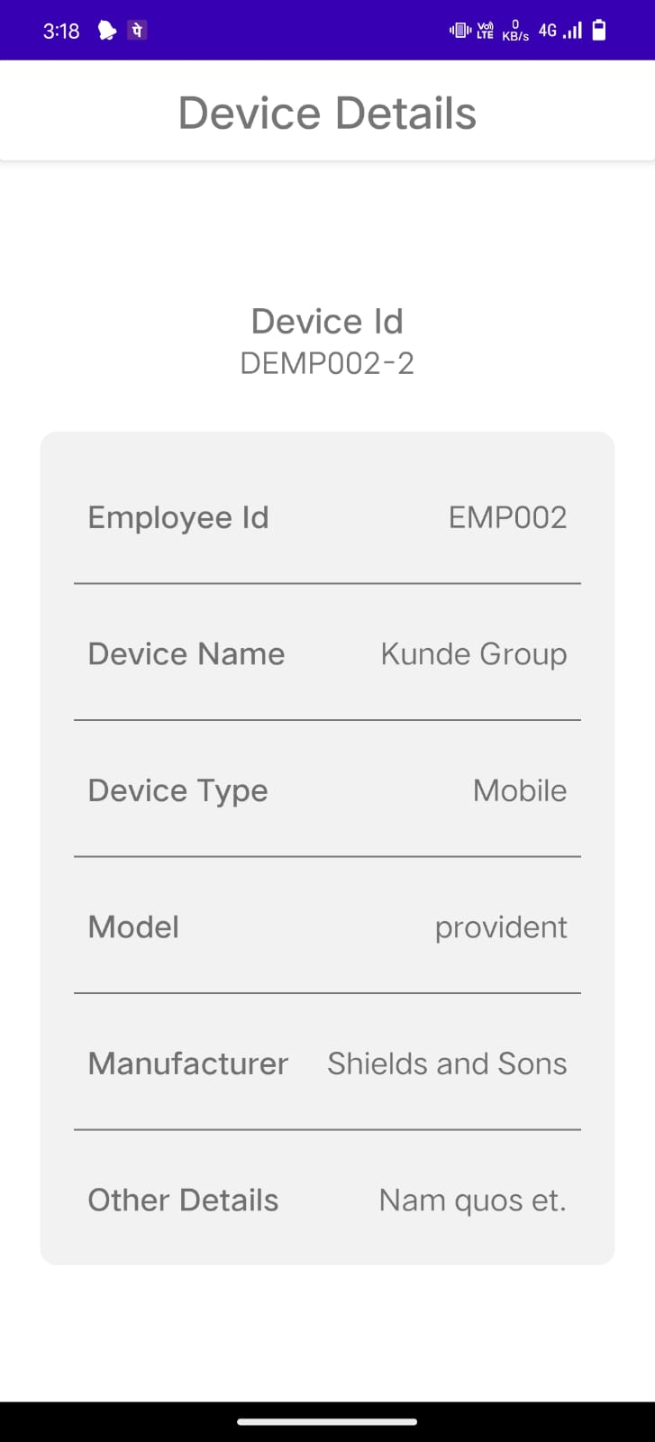
Device DETAIL screen
Device detail screen displays the device information such as employee id, device id, device name, device type, model, manufacturer, other details.

Slide 13
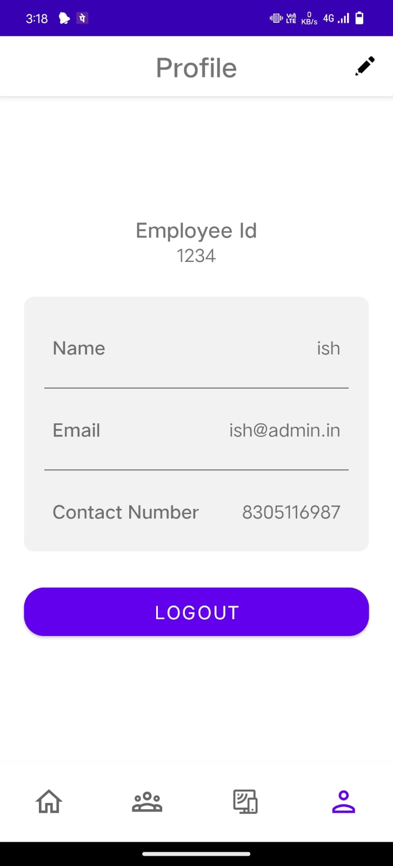
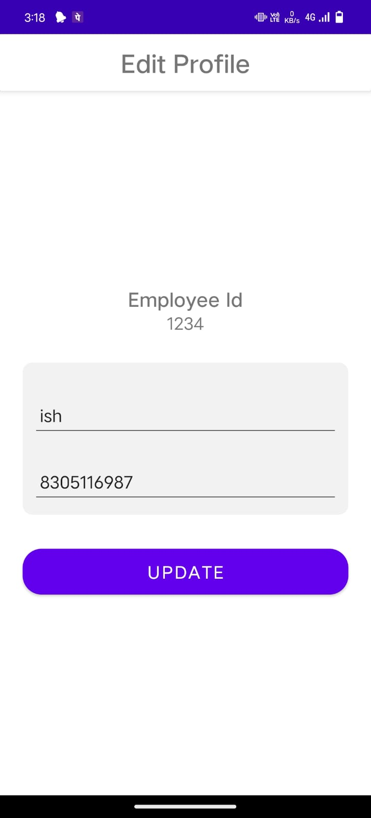
Profile screen
The fourth icon on the dashboard is the profile screen. It displays the administrator's profile information and includes a logout button.
The toolbar also features an edit profile button. Clicking this button opens the edit profile screen where the administrator can update their name and phone number.
The update button saves the changes made to the profile fields.
Logout Button: The logout button allows administrators to securely log out of the system.

Slide 14
THANK YOU
Ishika Nimade

